Slide 1

General principles of EU environmental law
By Gianmario Palliggiano
Association of Bulgarian administrative judge/AEAJ
Workshop in Sofia on 4 -5 Jun 2015

Slide 2
INTRODUCTION
What is enviroment?
Is it possible a joint definition?

Slide 3
Primary Legislation
Treaty on European Union (TEU)
Article 3, par. 3 (ex art. 2 TEC)
The Union shall establish an internal market. It shall work for the sustainable development of Europe based on balanced economic growth and price stability, a highly competitive social market economy, aiming at full employment and social progress, and a high level of protection and improvement of the quality of the environment. It shall promote scientific and technological advance
Association of Bulgarian administrative judge/AEAJ
Workshop in Sofia on 4 -5 Jun 2015
3
Notes:
3

Slide 4
Primary Legislation
Treaty on European Union (TEU)
Article 3, par. 5 (ex art. 2 TEC)
In its relations with the wider world, the Union shall uphold and promote its values and interests and contribute to the protection of its citizens. It shall contribute to peace, security, the sustainable development of the Earth, solidarity and mutual respect among peoples, free and fair trade, eradication of poverty and the protection of human rights, in particular the rights of the child, as well as to the strict observance and the development of international law, including respect for the principles of the United Nations Charter.
Association of Bulgarian administrative judge/AEAJ
Workshop in Sofia on 4 -5 Jun 2015
4

Slide 5
Primary Legislation
Treaty on the functioning of the EU (TFEU)
Article 11
„Environmental protection requirements must be integrated into the definition and implementation of the Union's policies and activities, in particular with a view to promoting sustainable development.“
Association of Bulgarian administrative judge/AEAJ
Workshop in Sofia on 4 -5 Jun 2015
5
Notes:
5

Slide 6
Primary Legislation
Treaty on the functioning of the EU (TFEU)
Article 5 (ex Art. 5 TEC)
1. The limits of Union competences are governed by the principle of conferral. The use of Union competences is governed by the principles of subsidiarity and proportionality.
3. Under the principle of subsidiarity, in areas which do not fall within its exclusive competence, the Union shall act only if and in so far as the objectives of the proposed action cannot be sufficiently achieved by the Member States, either at central level or at regional and local level, but can rather, by reason of the scale or effects of the proposed action, be better achieved at Union level.
4. Under the principle of proportionality, the content and form of Union action shall not exceed what is necessary to achieve the objectives of the Treaties.
Association of Bulgarian administrative judge/AEAJ
Workshop in Sofia on 4 -5 Jun 2015

Slide 7
Primary Legislation
Treaty on the functioning of the EU (TFEU)
Art. 191, par. 2 (ex article 174 TEC)
Union policy on the environment shall aim at a high level of protection taking into account the diversity of situations in the various regions of the Union. It shall be based on the precautionary principle and on the principles that preventive action should be taken, that environmental damage should as a priority be rectified at source and that the polluter should pay.“
Association of Bulgarian administrative judge/AEAJ
Workshop in Sofia on 4 -5 Jun 2015
7
Notes:
7

Slide 8
Primary Legislation
Charter of Fundamental Rights
of the European Union
Article 37 - Environmental protection
A high level of environmental protection and the improvement of the quality of the environment must be integrated into the policies of the Union and ensured in accordance with the principle of sustainable development.“
Association of Bulgarian administrative judge/AEAJ
Workshop in Sofia on 4 -5 Jun 2015
8
Notes:
Article 6 (1) TEU
“The Union recognises the rights, freedoms and principles set out in the Charter of Fundamental Rights of the European Union of 7 December 2000, as adapted at Strasbourg, on 12 December 2007, which shall have the same legal value as the Treaties.”
8

Slide 9
Primary legislation
ENVIRONMENTAL GENERAL and DIRECT PRINCIPLES
OVERALL PICTURE
Art. 3 TEU (ex art. 2 TEC); art. 37 CFR
- Protection (high level- HLP) -
- Improvement of the quality of the environment (IQE)
Art. 3 TEU (ex art. 2 TEC) and Art. 11 TFUE; art. 37 CFR
- Sustainable Development (SD)
Art. 11 TFUE
  Prevention (PREV)
  Rectification of Pollution at Source (RPS)
Art. 191 TFUE (ex art. 174 TEC)
  Precaution (PREC)
  ‘Polluter pays’ (PP)
Notes:
Article 4 (1) TEU
“In accordance with Article 5, competences not conferred upon the Union in
the Treaties remain with the Member States. “
Article 5 (2) TEU
“Under the principle of conferral, the Union shall act only within the limits of the competences conferred upon it by the Member States in the Treaties to attain the objectives set out therein. Competences not conferred upon the Union in the Treaties remain with the Member States.”
Case C – 176/03 Commission v Council, annulment of the Council Framework Decision 2003/80/JHA of 27 January 2003 on the protection of the environment through criminal law due to lack of competence
“27. Not only is there no express conferral of power in that regard, but, given the considerable significance of criminal law for the sovereignty of the Member States, there are no grounds for accepting that this power can have been implicitly transferred to the Community at the time when specific substantive competences, such as those exercised under Article 175 EC, were conferred on it.”

Slide 10
Primary legislation
EUROPEAN GENERAL PRINCIPLES WITH
INDIRECT EFFECTS ON THE ENVIROMENT PROTECTION
CONFERRAL (art. 5 TEU, ex art. 5 TEC)
The limits of Union competences are governed by the principle of conferral
Under the principle of conferral, the Union shall act only within the limits of the competences conferred upon it by the Member States in the Treaties to attain the objectives set out therein.
Competences not conferred upon the Union in the Treaties remain with the Member States
The use of Union competences is governed by the principles of:
- SUBSIDIARITY
- PROPORTIONALITY
Association of Bulgarian administrative judge/AEAJ
Workshop in Sofia on 4 -5 Jun 2015

Slide 11
Primary legislation
EUROPEAN GENERAL PRINCIPLES WITH
EFFECTS ON THE ENVIROMENT PROTECTION
- SUBSIDIARITY (art. 5 TEU, par. 3 - ex art. 5 TEC)
Under the principle of subsidiarity, in areas which do not fall within its exclusive competence, the Union shall act only if and in so far as the objectives of the proposed action cannot be sufficiently achieved by the Member States, either at central level or at regional and local level, but can rather, by reason of the scale or effects of the proposed action, be better achieved at Union level
The institutions of the Union shall apply the principle of subsidiarity as laid down in the Protocol on the application of the principles of subsidiarity and proportionality. National Parliaments ensure compliance with the principle of subsidiarity in accordance with the procedure set out in that Protocol
Association of Bulgarian administrative judge/AEAJ
Workshop in Sofia on 4 -5 Jun 2015

Slide 12
Primary legislation
EUROPEAN GENERAL PRINCIPLES WITH
EFFECTS ON THE ENVIROMENT PROTECTION
- PROPORTIONALITY (art. 5 TEU, ex art. 5 TEC, PAR. 4)
Under the principle of proportionality, the content and form of Union action shall not exceed what is necessary to achieve the objectives of the Treaties.
The institutions of the Union shall apply the principle of proportionality as laid down in the Protocol on the application of the principles of subsidiarity and proportionality
Association of Bulgarian administrative judge/AEAJ
Workshop in Sofia on 4 -5 Jun 2015

Slide 13
Relationship among enviromental principles
Traditional approach
Hierarchy
Association of Bulgarian administrative judge/AEAJ
Workshop in Sofia on 4 -5 Jun 2015

Slide 14
Relationship among enviromental principles
New approach:
NO Hierarchy
YES Mutual Integration:
Each principle can operate and strengthen only because of the other principles
Association of Bulgarian administrative judge/AEAJ
Workshop in Sofia on 4 -5 Jun 2015

Slide 15
HIGH LEVEL OF PROTECTION
Article 193 TFEU
The protective measures adopted pursuant to Article 192 shall not prevent any Member State from maintaining or introducing more stringent protective measures. Such measures must be compatible with the Treaties. They shall be notified to the Commission.
Court of Justice of the European Union (CJEU) Case C-284/95 judgment of 14 July 1998, Safety Hi-Tech Srl
(Regulation (EC) No 3093/94 , Measures to protect the ozone layer)
“(49) Finally, whilst it is undisputed that …the Treaty requires Community policy in environmental matters to aim for a high level of protection, such a level of protection, to be compatible with that provision, does not necessarily have to be the highest that is technically possible. …”
Association of Bulgarian administrative judge/AEAJ
Workshop in Sofia on 4 -5 Jun 2015
15
Notes:
C-6/03, Deponiezweckverband Eiterköpfe, judgment of 14 April 2005, compatibility of more stringent protective measures with the Community legislation governing the landfill of waste.
“52. It follows that a measure of domestic law, such as that at issue in the main proceedings, which seeks to reduce the amount of waste going to landfill and which applies to waste other than municipal waste, is compatible with the Directive and constitutes a more stringent protective measure for the purposes of Article 176 EC.”
15

Slide 16
SUSTAINABLE DEVELOPMENT
Expression
- attributed conventionally to report "Our Common Future" in 1987, prepared by independent experts, better known as the Brundtland Report (Prime Minister of Norway);
approved by the General Assembly of the United Nations, res. n. 42/187, 1987, December 11°
Definition
Development that meets the needs of the present without compromising the ability of future generations to meet their needs
This definition encloses two concepts
  needs, which is to be referred, in particular, to most disadvantaged people
  limitless of our natural resources
Association of Bulgarian administrative judge/AEAJ
Workshop in Sofia on 4 -5 Jun 2015

Slide 17
SUSTAINABLE DEVELOPMENT
7th EAP Environmental Action Programme
Decision No 1386/2013/EU of the European Parliament and of the Council of 20 November 2013 on a General Union Environment Action Programme to 2020
‘Living well, within the limits of our planet’
EAP
will guide European environment policy until 2020.
In order to give more long-term direction it sets out a vision beyond that, of where it wants the Union to be by 2050:
In 2050, we live well, within the planet’s ecological limits. Our prosperity and healthy environment stem from an innovative, circular economy where nothing is wasted and where natural resources are managed sustainably, and biodiversity is protected, valued and restored in ways that enhance our society’s resilience. Our low-carbon growth has long been decoupled from resource use, setting the pace for a safe and sustainable global society."
Association of Bulgarian administrative judge/AEAJ
Workshop in Sofia on 4 -5 Jun 2015

Slide 18
SUSTAINABLE DEVELOPMENT
7th EAP Environmental Action Programme
1) THREE KEY OBJECTIVES:
- to protect, conserve and enhance the Union’s natural capital
- to turn the Union into a resource-efficient, green, and competitive low-carbon economy
- to safeguard the Union's citizens from environment-related pressures and risks to health and wellbeing
2) FOUR SO CALLED "ENABLERS" HELP EUROPE DELIVER ON THESE GOALS:
- better implementation of legislation
- better information by improving the knowledge base (access to enviromental information)
- more and wiser investment for environment and climate policy
- full integration of environmental requirements and considerations into other policies
3) TWO ADDITIONAL HORIZONTAL PRIORITY OBJECTIVES complete the programme:
- to make the Union's cities more sustainable
- to help the Union address international environmental and climate challenges more effectivel
Association of Bulgarian administrative judge/AEAJ
Workshop in Sofia on 4 -5 Jun 2015

Slide 19
SUSTAINABLE DEVELOPMENT
Is it the SD principle current yet?
Current problem, while considering the environmental situation of the planet, is no longer the objective of preserving resources for future generations, but rather in meeting the current and immediate needs (especially in the southern hemisphere) that the environmental and social crisis, amplified by the processes of globalization, has brought to the attention of the international community
from Sustainable development to Desirable development
Set of possible solutions to economic, social and environmental aspects of the planet
Binding principle?
CJEU, III, 04/03/2015, C- 534/13, Fipa groups/Comune di Massa
The prevention and rectification of environmental damage should be implemented through the "polluter pays" principle, as indicated in the Treaty and in line with the principle of sustainable development.
Association of Bulgarian administrative judge/AEAJ
Workshop in Sofia on 4 -5 Jun 2015

Slide 20
PRECAUTIONARY PRINCIPLE
The precautionary principle or precautionary approach states that if an action or policy has a suspected risk of causing harm to the public or to the environment, in the absence of scientific consensus that the action or policy is not harmful, the burden of proof that it is not harmful falls on those taking an action.
The precautionary principle enables rapid response in the face of a possible danger to human, animal or plant health, or to protect the environment. In particular, where scientific data do not permit a complete evaluation of the risk, recourse to this principle may, for example, be used to stop distribution or order withdrawal from the market of products likely to be hazardous
Association of Bulgarian administrative judge/AEAJ
Workshop in Sofia on 4 -5 Jun 2015

Slide 21
PRECAUTIONARY PRINCIPLE
Word Charter for Nature
Regarding international conduct, the first endorsement of the principle was in 1982 when the World Charter for Nature was adopted by the United Nations General Assembly, while its first international implementation was in 1987 through the Montreal Protocol. Soon after, the principle integrated with many other legally binding international treaties such as the Rio Declaration and Kyoto Protocol
Communication from the Commission of 2 February 2000 on the precautionary principle
This Communication establishes common guidelines on the application of the precautionary principle.
The definition of the principle shall also have a positive impact at international level, so as to ensure an appropriate level of environmental and health protection in international negotiations. It has been recognised by various international agreements, notably in the Sanitary and Phytosanitary Agreement (SPS) concluded in the framework of the World Trade Organisation (WTO).
Association of Bulgarian administrative judge/AEAJ
Workshop in Sofia on 4 -5 Jun 2015
21
Notes:
21

Slide 22
PRECAUTIONARY PRINCIPLE
Features of the precautionary principle
1.- The principle is used by policy makers to justify discretionary decisions in situations where there is the possibility of harm from taking a particular course or making a certain decision when extensive scientific knowledge on the matter is lacking.
2.- The principle implies that there is a social responsibility to protect the public from exposure to harm, when scientific investigation has found a plausible risk. These protections can be relaxed only if further scientific findings emerge that provide sound evidence that no harm will result.
3.- In some legal systems, such as European Union, precautionary principle has been made a statutory requirement in some areas of law
Association of Bulgarian administrative judge/AEAJ
Workshop in Sofia on 4 -5 Jun 2015

Slide 23
PRECAUTIONARY PRINCIPLE
Programmatic but binding principle
General Court, Cases T-74/00 et alt.
Artegodan GmbH and others, judgment of 26 November 2002
(Withdrawal of marketing authorizations of medicinal products)
(182) …
”As regards environmental matters, the precautionary principle is expressly enshrined in Article 174(2) EC, which establishes the binding nature of that principle.”
Notes:
T-74/00
“184.
It follows that the precautionary principle can be defined as a general principle of Community law requiring the competent authorities to take appropriate measures to prevent specific potential risks to public health, safety and the environment, by giving precedence to the requirements related to the protection of those interests over economic interests. Since the Community institutions are responsible, in all their spheres of activity, for the protection of public health, safety and the environment, the precautionary principle can be regarded as an autonomous principle stemming from the abovementioned Treaty provisions….”

Slide 24
PRECAUTIONARY PRINCIPLE
The addressee of the principle
  Firstly: Legislator
  Secondly: Public authorities and Courts
Communication from the Commission on the precautionary principle , COM (2000)1 p.10
“Like other general notions contained in the legislation, such as subsidiarity or proportionality, it is for the decision-makers and ultimately the courts to flesh out the principle. In other words, the scope of the precautionary principle also depends on trends in case law, which to some degree are influenced by prevailing social and political values.”

Slide 25
PRECAUTIONARY PRINCIPLE
The precautionary principle is informed by five general and three specific criteria
COM(2000)1 Compliance with other principles of EU law Measures must be
1) Five general criteria
The general principles of risk management remain applicable when the precautionary principle is invoked. These are the following five criteria:
proportionality between the measures taken and the chosen level of protection;
non-discrimination in application of the measures;
consistency with similar measures already taken;
examination of the benefits and costs of action or lack of action;
review of the measures in the light of new scientific data.
2) Three specific criteria
The most complete scientific evaluation, the determination, as far as possible, of the degree of scientific uncertainty; capability to assigne responsibility for producing the scientific evidence necessary for a more comprehensive risk assessment
a risk evaluation of the potential consequences of inaction;
the participation of all interested parties in the study of precautionary measures, once the results of the scientific evaluation and/or the risk evaluation are available.
Association of Bulgarian administrative judge/AEAJ
Workshop in Sofia on 4 -5 Jun 2015

Slide 26
PRECAUTIONARY PRINCIPLE
CJEU case law:
C-302/86, Commission v Denmark, judgment of 21 September 1988, proportionality, free movement of goods, Danish bottles
C- 203/96, Chemische Afvalstoffen, judgment of 25 June
1998, export of waste for recovery, free movement of goods,
ex Article 130 t EC (now Article 193 TFEU)
C- 463/01, Commision v Germany, judgment of 14 December 2004,
packaging and packaging waste
Notes:
C- 302/86
“21. Nevertheless, the system for returning non-approved containers is capable of protecting the environment and, as far as imports are concerned, affects only limited quantities of beverages compared with the quantity of beverages consumed in Denmark owing to the restrictive effect which the requirement that containers should be returnable has on imports . In those circumstances, a restriction of the quantity of products which may be marketed by importers is disproportionate to the objective pursued .
22. It must therefore be held that by restricting, by Order No 95 of 16 March 1984, the quantity of beer and soft drinks which may be marketed by a single producer in non-approved containers to 3 000 hectolitres a year, the Kingdom of Denmark has failed, as regards imports of those products from other Member States, to fulfil its obligations under Article 30 of the EEC Treaty .”
C-203/09
“50. In those circumstances the answer to the first question must be that the Directive and the Regulation cannot be interpreted as meaning that the principles of self-sufficiency and proximity are applicable to shipments of waste for recovery. Article130t of the Treaty does not permit Member States to extend the application of those principles to such waste when it is clear that they create a barrier to exports which is not justified either by an imperative measure relating to protection of the environment or by one of derogations provided for by Article 36 of the Treaty.”
C-463/01
“78. However, in order for such rules to comply with the principle of proportionality, it must be ascertained not only whether the means which they employ are suitable for the purpose of attaining the desired objectives but also whether those means do not go beyond what is necessary for that purpose (see Case C-284/95 Safety Hi-Tech [1998] ECR I-4301, paragraph 57).”

Slide 27
PRECAUTIONARY PRINCIPLE
The PP is integrated by many measures of secondary EU law, see e.g.
Regulation (EC) N. 1907/2006: concerning the Registration, Evaluation, Authorisation and Restriction of Chemicals (REACH),
Regulation (EC) N. 1272/2008 on Classification, Labelling and Packaging of substances and mixtures (CLP)
Secondary legislation on Genetically Modified Organisms (GMOS)
Directive 2012/18/EU on the control of major-accident hazards involving dangerous substances (“SEVESO III”)

Slide 28
PRECAUTIONARY PRINCIPLE
Directive 2011/92
(Environmental Impact Assessment),
Appropriate Assessment of Implications according to Article 6(3) Habitats Directive (92/43/EEC)
Sentence 1
“Any plan or project not directly connected with or necessary to the management of the site but likely to have a significant effect thereon, either individually or in combination with other plans or projects, shall be subject to appropriate assessment of its implications for the site in view of the site’s conservation objectives. ….”
Notes:
C—127/02
“44
In the light, in particular, of the precautionary principle, which is one of the foundations of the high level of protection pursued by Community policy on the environment, in accordance with the first subparagraph of Article 174(2) EC, and by reference to which the Habitats Directive must be interpreted, such a risk exists if it cannot be excluded on the basis of objective information that the plan or project will have significant effects on the site concerned. … “

Slide 29
PRECAUTIONARY PRINCIPLE
Habitats Directive (92/43/EEC)
Article 3 (3)
Sentence 2
…In the light of the conclusions of the assessment of the implications for the site and subject to the provisions of paragraph 4, the competent national authorities shall agree to the plan or project only after having ascertained that it will not adversely affect the integrity of the site concerned and, if appropriate, after having obtained the opinion of the general public.”
CJEU C‑127/02,Waddenzee,
judgment of 7 September 2004
Notes:
C-127/02
“58
In this respect, it is clear that the authorisation criterion laid down in the second sentence of Article 6(3) of the Habitats Directive integrates the precautionary principle…”
“59
Therefore, pursuant to Article 6(3) of the Habitats Directive, the competent national authorities, taking account of the conclusions of the appropriate assessment of the implications of mechanical cockle fishing for the site concerned, in the light of the site’s conservation objectives, are to authorise such activity only if they have made certain that it will not adversely affect the integrity of that site. That is the case where no reasonable scientific doubt remains as to the absence of such effects (see, by analogy, Case C-236/01 Monsanto Agricoltura Italia and Others [2003] ECR I-0000, paragraphs 106 and 113).”
The furthermore:
C‑258/11,Sweetman, 11 April 2013, para 41
C‑258/11, Briels a.o., 15 May 2014, para 26

Slide 30
PREVENTION
Prevention is an overall environmental principle and is linked with other principles (rectification at source, precaution).
Prevent rather than cure!
In case of an identified danger of harm prevention is mandatory.
Concerning industrial emissions:
Directive 2010/75/EU (Integrated Pollution Prevention and Control)

Slide 31

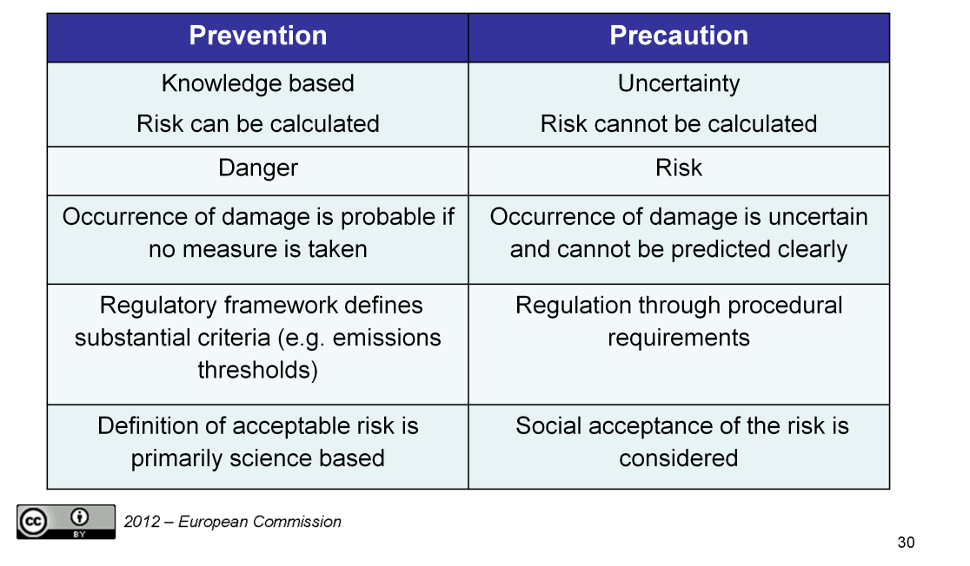

Slide 32

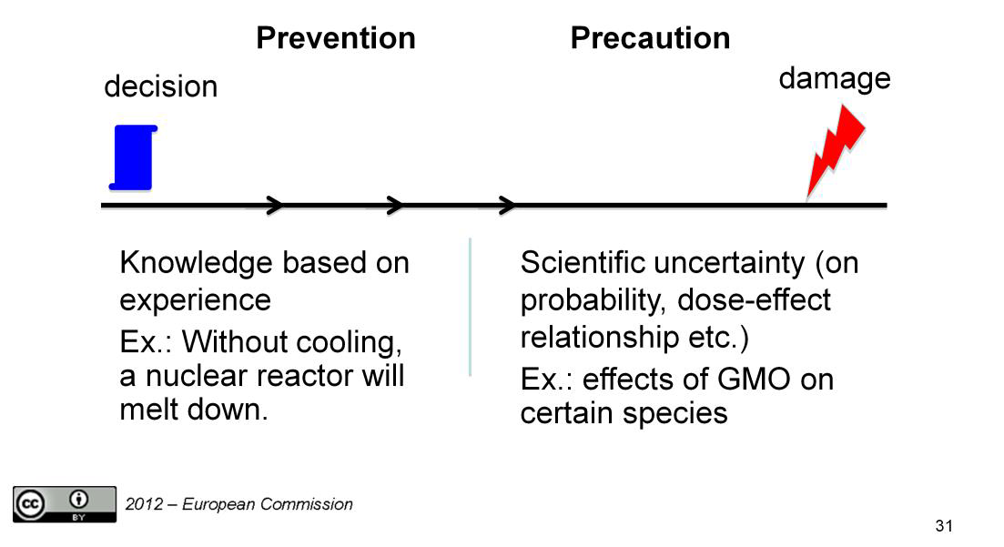

Slide 33
POLLUTER PAYS and RECTIFICATION of POLLUTION at SOURCE PRINCIPLES (PP - RPS)
The European Union (EU) establishes a common framework for liability with a view to preventing and remedying damage to animals, plants, natural habitats and water resources, and damage affecting the land.
ACT
Directive 2004/35/EC of the European Parliament and of the Council of 21 April 2004 on environmental liability with regard to the prevention and remedying of environmental damage.
SUMMARY
The Directive establishes a framework for environmental liability based on the polluter pays principle, with a view to preventing and remedying environmental damage.
ENVIRONMENTAL DAMAGE
Under the terms of the Directive, environmental damage is defined as:
direct or indirect damage to the aquatic environment covered by Community water management legislation and by the Framework Directive relating to marine strategy
direct or indirect damage to species and natural habitats protected at Community level by the 1979 Birds Directive or by the 1992 Habitats Directive;
direct or indirect contamination of the land which creates a significant risk to human health
Association of Bulgarian administrative judge/AEAJ
Workshop in Sofia on 4 -5 Jun 2015

Slide 34
POLLUTER PAYS and RECTIFICATION of POLLUTION at SOURCE PRINCIPLES (PP - RPS)
The PPP is integrated by many measures of secondary EU law, see e.g.
Directive 2004/35/EC on environmental liability with regard to the prevention and remedying of environmental damage (ELD)
Directive 2003/87/EC establishing a scheme for greenhouse gas emission allowance trading within the Community
Notes:
The ELD establishes a framework based on the polluter pays principle to prevent and remedy environmental damage. As the ELD deals with the "pure ecological damage", it is based on the powers and duties of public authorities ("administrative approach") as distinct from a civil liability system for "traditional damage" (damage to property, economic loss, personal injury).
The EU Emissions Trading System(ETS) is a 'cap and trade' system, that is to say it caps the overall level of emissions allowed but, within that limit, allows participants in the system to buy and sell allowances as they require. These allowances are the common trading 'currency' at the heart of the system. One allowance gives the holder the right to emit one tonne of CO₂ or the equivalent amount of another greenhouse gas. The cap on the total number of allowances creates scarcity in the market.

Slide 35
POLLUTER PAYS and RECTIFICATION of POLLUTION at SOURCE PRINCIPLES (PP - RPS)
Scope of the principle of liability
The principle of liability applies to environmental damage and imminent threat of damage resulting from occupational activities, where it is possible to establish a causal link between the damage and the activity in question.
The Directive 2004/35/EC distinguishes between two complementary situations, each one governed by a different liability scheme:
  occupational activities specifically mentioned in the Directive, Annex III
  other occupational activities.
Association of Bulgarian administrative judge/AEAJ
Workshop in Sofia on 4 -5 Jun 2015

Slide 36
POLLUTER PAYS and RECTIFICATION of POLLUTION at SOURCE PRINCIPLES (PP - RPS)
The first liability scheme applies to the dangerous or potentially dangerous occupational activities listed in Annex III to the Directive. These are mainly:
  agricultural or industrial activities requiring a licence under the Directive on integrated pollution prevention and control;
  activities which discharge heavy metals into water or the air;
  installations producing dangerous chemical substances;
  waste management activities (including landfills and incinerators); and activities concerning genetically modified organisms and micro-organisms.
In those cases, the operator may be held responsible even if he is not at fault.
The second liability scheme applies to all occupational activities other than those listed in Annex III to the Directive, but only where there is damage, or imminent threat of damage, to species or natural habitats protected by Community legislation.
In this case, the operator will be held liable only if he is at fault or negligent.
The Directive provides for a certain number of exemptions from environmental liability. The liability scheme does not apply in the case of damage or imminent damage resulting from armed conflict, natural disaster, activities covered by the Treaty establishing the European Atomic Energy Community, national defence or international security activities or activities covered by the international conventions listed in Annex IV.
Association of Bulgarian administrative judge/AEAJ
Workshop in Sofia on 4 -5 Jun 2015

Slide 37
POLLUTER PAYS and RECTIFICATION of POLLUTION at SOURCE PRINCIPLES (PP - RPS)
C-293/97, 28 April 1999, National Farmers' Union
Directive 91/676 - Identification of `waters affected by pollution' - Principle of proportionality - Polluter pays principle and principle that environmental damage should as a priority be rectified at source - Right to property;
C-389/00, 27 February 2003, Commission v Germany
“By subjecting shipments of waste to other Member States to a mandatory contribution to the solidarity fund for the return of waste …the Federal Republic of Germany has failed to fulfil its obligations under Articles 23 EC and 25 EC .“ (now: Articles
28, 34 TFEU)
Association of Bulgarian administrative judge/AEAJ
Workshop in Sofia on 4 -5 Jun 2015
Notes:
C-293/97
Summary
2.
„…
As regards the polluter pays principle, the directive does not mean that farmers must take on burdens for the elimination of pollution to which they have not contributed, because the Member States are to take account of the other sources of pollution when implementing the directive and, having regard to the circumstances, are not to impose on farmers costs of eliminating pollution that are unnecessary. Viewed in that light, the polluter pays principle reflects the principle of proportionality. The same applies to the principle that environmental damage should as a priority be rectified at source.
… “

Slide 38
POLLUTER PAYS and RECTIFICATION of POLLUTION at SOURCE PRINCIPLES (PP - RPS)
C‑188/07, 24 June 2008 Commune de Mesquer (Erika)
Waste management – Concept of waste – ‘Polluter pays’ principle – Holder – Previous holders – Producer of the product from which the waste came – Hydrocarbons and heavy fuel oil – Shipwreck – International Convention on Civil Liability for Oil Pollution Damage – International Oil Pollution Compensation Fund
Association of Bulgarian administrative judge/AEAJ
Workshop in Sofia on 4 -5 Jun 2015
Notes:
Summary:
“…
The application of the ‘polluter pays’ principle within the meaning of the second sentence of the first subparagraph of Article 174(2) EC and Article 15 of Directive 75/442 on waste, as amended by Decision 96/350, would be frustrated if persons involved in causing waste, whether holders or former holders of the waste or even producers of the product from which the waste came, escaped their financial obligations as provided for by that directive, even though the origin of the hydrocarbons which were spilled at sea, albeit unintentionally, and caused pollution of the coastal territory of a Member State was clearly established.
…“

Slide 39
POLLUTER PAYS and RECTIFICATION of POLLUTION at SOURCE PRINCIPLES (PP - RPS)
C‑379/08 and C‑380/08, 9 March 2010, Raffinerie Mediterranee and others,
“2. In circumstances such as those in the main proceedings, Directive 2004/35 does not preclude national legislation which permits the competent authority to make the exercise by operators at whom environmental recovery measures are directed of the right to use their land subject to the condition that they carry out the works required by the authority, even though that land is not affected by those measures because it has already been decontaminated or has never been polluted. However, such a measure must be justified by the objective of preventing a deterioration of the environmental situation in the area in which those measures are implemented or, pursuant to the precautionary principle, by the objective of preventing the occurrence or resurgence of further environmental damage on the land belonging to the operators which is adjacent to the whole shoreline at which those remedial measures are directed.”
Association of Bulgarian administrative judge/AEAJ
Workshop in Sofia on 4 -5 Jun 2015

Slide 40
POLLUTER PAYS and RECTIFICATION of POLLUTION at SOURCE PRINCIPLES (PP - RPS)
C‑534/13, 4 March 2015, Fipa Group Srl,
“Directive 2004/35/EC of the European Parliament and of the Council of 21 April 2004 on environmental liability with regard to the prevention and remedying of environmental damage must be interpreted as not precluding national legislation such as that at issue in the main proceedings, which, in cases where it is impossible to identify the polluter of a plot of land or to have that person adopt remedial measures, does not permit the competent authority to require the owner of the land (who is not responsible for the pollution) to adopt preventive and remedial measures, that person being required merely to reimburse the costs relating to the measures undertaken by the competent authority within the limit of the market value of the site, determined after those measures have been carried out.”
Association of Bulgarian administrative judge/AEAJ
Workshop in Sofia on 4 -5 Jun 2015

Slide 41

Thanks for your attention !

